Slide 1
RAC Performance Diagnostics
Using AWR
Michael Zoll, Atsushi Morimura
RAC Performance Group
April 2020

Slide 2
Agenda
1
Introduction to RAC
2
Common Cache Fusion Messaging Patterns & Wait Events
3
Common RAC Performance Bottlenecks
4
Diagnostic Information
5
Case Studies

Slide 3
Agenda
1
Introduction to RAC
2
Common Cache Fusion Messaging Patterns & Wait Events
3
Common RAC Performance Bottlenecks
4
Diagnostic Information
5
Case Studies

Slide 4
Single Instance Architecture
Clients
Single Instance Architecture (non-RAC)
SQL Execution
Clients access a single Database instance.
Data is cached in the buffer cache.
Database Instance
Buffer Cache
Storage
Notes:
We start with explaining the basic architecture.
It is very important to understand this before we discuss the RAC optimizations later on.

Slide 5
RAC Architecture
Clients
Clustered Architecture (RAC)
Storage is shared by all Database instances.
Network interconnect connects all instances.
Clients can connect to any instance to access data.
Each instance maintains its own buffer cache.
Buffer cache is shared across all instances via the interconnect.
This protocol is called Cache Fusion.
Enqueue access is also globally coordinated (Global Enqueues).
SQL Execution
Database
Instances
Buffer Cache
Buffer Cache
Buffer Cache
Storage

Slide 6
RAC Architecture
Clients
Distributed Lock Management
SQL Execution
RAC ensures data coherency using the distributed lock manager (DLM).
Each data block or enqueue has a resource master.
Resource masters are distributed across all instances.
Before reading or modifying a data block, clients need to get a lock from the resource master.
Database
Instances
Buffer Cache
Buffer Cache
Buffer Cache
Storage

Slide 7
RAC Architecture
Clients
LMS Background Process
SQL Execution
LMS background processes run on each RAC instance.
The number depends on the CPU_COUNT.
LMS’s serve as resource masters for buffer cache locks.
Clients will send lock request messages to remote LMS’s.
LMS’s run in SCHED_RR.
Database
Instances
Buffer Cache
Buffer Cache
Buffer Cache
Storage

Slide 8
RAC Architecture
Clients
Other Background Process
SQL Execution
LMD:
Global enqueue services
LMON:
Cluster membership & HA
LMHB:
Process health monitor
Database
Instances
Buffer Cache
Buffer Cache
Buffer Cache
Storage

Slide 9
Agenda
1
Introduction to RAC
2
Common Cache Fusion Messaging Patterns & Wait Events
3
Common RAC Performance Bottlenecks
4
Diagnostic Information
5
Case Studies

Slide 10
Common Cache Fusion Messaging Patterns
2-way Block Transfer
Foreground sends request to remote LMS, LMS sends a data block back.
Master is local, holder is remote.
Master is remote, and is also the holder.
3-way Block Transfer
Foreground sends request to remote LMS, LMS forwards request to holder LMS, holder LMS sends a data block back.
Master is remote, holder is on another remote instance.
2-way Lock Grant
Foreground sends request to remote LMS, LMS sends a lock grant back.
Master is remote, buffer is not held anywhere.
Data is read from disk.
Instance 1
Instance 1
Instance 2
FG
Instance 1
Instance 2
Request
Request
FG
LMS
Data Block Transfer
Request
FG
LMS
Instance 3
Instance 2
Data Block Transfer
LMS
LMS
Disk I/O
Lock Grant
Forward
No matter the size of the cluster, requests are always satisfied in ≤ 3 hops
Notes:
If master is remote, you can grant yourself the lock and go directly to storage.
The more instances you have, the less locality you’ll have.

Slide 11
Common Cache Fusion Wait Events
Waiting for a buffer (or lock grant) transfer from a remote instance
Request outcome: (what was returned from server)
Short for “Global Cache”
gc [cr|current] [block|grant] [2-way|3-way|busy|congested]
Type of block requested:
CR: consistent read
Current: current pin
Performance hint
Wait event parameters: p1: file#
p2: block#
p3: encoded value includes block class, held/requested modes

Slide 12
Common Cache Fusion Wait Events
The “performance hint”
2-way / 3-way:
Received an immediate response back from the master or holder instance.
Congested:
Request was processed immediately, but was stuck in LMS for more than 1ms (KCL_WAIT_LMS_MAX).
Usually indicates LMS starvation.
Busy:
If LMS is unable to immediately service the request, processing gets queued.
AWR will help explain the reason.
A dirty buffer had to be sent, so a REDO log flush was initiated.
The buffer was pinned by another process.
The buffer lock was held in an incompatible mode.
Instance 1
Instance 2
Request
FG
LMS
REDO log flush
Data Block Transfer

Slide 13
Common Cache Fusion Wait Events
Details, Expectations and Probable Causes for Abnormalities
gc [cr|current] block [2|3]-way
Expected Latency: < 1 ms (< 100 us on Exadata for 2-way)
Reasons for abnormal : Interconnect congestion , high CPU load and priority inversion , LMS not in RT
gc [cr|current] block congested
We should not see this event on healthy systems
Reasons for abnormal: LMS load spikes
gc [cr|current] block busy
Expected latency : log file parallel write + latency of immediate send
Reasons for abnormal: log flush time, application contention on hot blocks, high CPU load and priority inversion

Slide 14
Common Cache Fusion Wait Events
Concurrency waits for globally-busy buffers
“ACQUIRE”: someone wants to read a remote block, and the request has not yet completed.
The remote block transfer is likely in-process by another local client.
“RELEASE”: a block got released (pinged away) because it was requested by another instance.
Upon completion of this wait, the client may be able to pin the buffer right away (since the buffer has subsequently been ACQUIRE’d by another client), or in some cases, the lock request will need to be re-started again.
Don’t confuse these with the “gc [cr|current] [block|grant] busy” waits.
These typically indicate that there is another session taking long to read a remote buffer.
gc buffer busy [acquire|release]
Notes:
From Neil:
--------
On Apr 7, 2020, at 5:12 PM, Neil Macnaughton <neil.macnaughton@oracle.com> wrote: correct for "release" the buffer is actually in the local cache, but has been basted, so the wait time is 1) the bast has to complete and the buffer sent to another instance; and 2) the buffer has to be pinged back to this instance (which is the same as the "acquire" wait time). On 4/7/2020 4:50 PM, Atsushi Morimura wrote: Hi Neil, Could you please see if the following explanation / understanding is true? - gc buffer busy acquire: Another client is reading the same buffer from a remote instance. The wait will complete once this buffer becomes available in the local cache and the FG is able to pin it. - gc buffer busy release: Same situation as acquire, but the buffer got pinged away and the client was unable to pin it. The request will be re-tried. Thanks!

Slide 15
Common Cache Fusion Wait Events
Other common wait events
gc [cr|current] request
Used for in-process buffer requests (reported in ASH, hang analyze, etc. but never in AWR).
Wait event is “fixed-up” upon completion to:
“gc [cr|current] [block|grant] [2-way|3-way|busy|congested]”
gc [cr|current] block direct read
Exadata only.
RDMA-read of a remote buffer (typically < 10 us with no dependency on server-side load).
gc [cr|current] multi block [request|grant|mixed]
A batch of requests were initiated by the client.
“request” is used when all requests were fulfilled via block transfers.
“grant” is used when all requests were fulfilled via lock grants (disk I/O’s will follow).
“mixed” is used when we got a mixture of both.

Slide 16
Common Wait Event Dependencies
Most likely reasons and solutions
log file parallel write -> gc [cr|current] block busy
Log writes on sender instance block cache fusion sends.
Generally log IO related.
Tune DML schema or SQL to reduce hot blocks.
gc [cr|current] block busy -> gc buffer busy acquire
A session tries to pin a buffer which is/was pinned by another session waiting for a Cache Fusion transfer from another node.
gc buffer busy is indicative of serialization.
Fix root cause (e.g. slow log writes) , or remove hot spots.
Often associated with other wait events
gc [cr|current] block busy - > enq: TX – index contention
gc [cr|current] block busy -> enq: TX - row contention
Dependencies are captured in ASH, based on session blocker/blocked information.

Slide 17
Common Cache Fusion Wait Events
Correlated/Supporting OS and AWR Statistics
gc [cr|current] block [2|3]-way ->
Run queue length and load average
LMS priority changes ( c.f. Slide 31 )
Signs of congestion on interconnect
gc [cr|current] block congested ->
LMS cpu utilization. ( c.f. Slide 32 )
Receive queue time ( c.f. Slide 32 )
gc [cr|current] block busy ->
Log file parallel write and log file sync in other instances
Pin and Flush statistics in other instances ( c.f. Slide 33 )

Slide 18
Agenda
1
Introduction to RAC
2
Common Cache Fusion Messaging Patterns & Wait Events
3
Common RAC Performance Bottlenecks
4
Diagnostic Information
5
Case Studies

Slide 19
1. Right-Growing Indexes
The index key uses a monotonically increasing value (sequence, timestamp, etc.).
Application INSERTs data into the B-tree at high concurrency.
Keys are stored in sorted order, so larger key values are stored in the right-most leaf, which become a global hot spot.

Slide 20
1. Right-Growing Indexes
Example of a workload showing lots of index leaf block contention
From internal testing (MAIN - 21c)
“gc buffer busy release/acquire” indicate global leaf block contention.
“buffer busy waits” indicate local leaf block contention.
“gc current *” waits correspond to the clients waits for reading the block from remote instances.
Total Wait Avg % DB Wait
Event Waits Time (sec) Wait time Class
------------------------------ ----------- ---------- --------- ------ --------
index split completion 398,024 9007.2 22.63ms 51.7 Concurrency
gc buffer busy release 662,941 3494.3 5.27ms 20.0 Cluster
gc buffer busy acquire 1,135,339 2625.7 2.31ms 15.1 Cluster
buffer busy waits 433,056 1067.4 2.46ms 6.1 Concurrency
latch: cache buffers chains 635,560 862.7 1.36ms 4.9 Concurrency
DB CPU 207.6 1.2
enq: TX - index contention 2,337 65.6 28.06ms .4 Concurrency
gc current block busy 6,368 21.5 3.37ms .1 Cluster
gc current grant busy 1,199 7.8 6.49ms .0 Cluster
gc current split 3,794 7.7 2.04ms .0 Cluster

Slide 21
2. Lots of Disk IO and Read-Read Buffer Sharing
Data set size > Buffer Cache size.
Lots of RAC instances (less locality).
The following example is from production Beehive (16 instances, 18c) from December 5, 2019.
This pattern usually scales well, but a load spike can lead to LMS saturation.
Event | Waits | Total Wait Time (sec) | Avg Wait | % DB time | Wait Class
DB CPU |  | 62.7K |  | 50.0
cell single block physical read | 1.6E+08 | 45.4K | 293.00us | 36.2 | User I/O
enq: TX - row lock contention | 92,288 | 8467.9 | 91.75ms | 6.8 | Application
cell list of blocks physical read | 1,459,363 | 3302.8 | 2.26ms | 2.6 | User I/O
gc current block 3-way | 10,932,950 | 3121.9 | 285.55us | 2.5 | Cluster
gc cr grant 2-way | 21,586,933 | 2187.1 | 101.32us | 1.7 | Cluster

Slide 22
2. Lots of Disk IO and Read-Read Buffer Sharing
LMS Workflow
LMS would receive requests from remote instances, and place them in a receive queue.
Once the incoming messages are received from the network, it will then process the receive queue.
Processing typically involves sending back a message or a data block
Once the receive queue is clear, receive the next batch of messages.
Higher volume of requests will lead to :
Longer receive queues
More requests waiting in the O/S (network adapter: HCA) before LMS receives them
Network
LMS
1. Receive
Receive Queue
2. Process

Slide 23
2. Lots of Disk IO and Read-Read Buffer Sharing
LMS queueing and saturation
Cache Fusion latency is usually not a problem when the load is light.
LMS’s processes incoming requests one-by-one, so requests will queue up under high load.
Once LMS’s are saturated, queueing becomes worse leading to bad overall performance.
This could happen during a load spike.
LMS’s run in SCHED_RR to minimize this risk.
One “sick” instance may impact the entire cluster.
One can alleviate the issue by increasing the # of LMS’s.
Deterministic performance under high load is usually very important in the real world.
Saturated
Getting queued up

Slide 24
2. Lots of Disk IO and Read-Read Buffer Sharing
What can happen if LMS’s become saturated?
From internal testing (19c)
A Linux issue caused scheduling delays for some LMS’s, leading to horrible latencies.
Event | Waits | Total Wait Time (sec) | Avg Wait | % DB time | Wait Class
gc cr grant congested | 89,808 | 10.9K | 120.92ms | 25.9 | Cluster
gc cr multi block grant | 199,188 | 8518 | 42.76ms | 20.3 | Cluster
gc cr grant busy | 1,078,089 | 7945.1 | 7.37ms | 19.0 | Cluster
DB CPU |  | 5327.7 |  | 12.7
cell single block physical read | 7,679,091 | 4719.9 | 614.65us | 11.3 | User I/O
gc cr grant 2-way | 2,636,614 | 2619.8 | .99ms | 6.3 | Cluster
log file sync | 1,177,066 | 2207.2 | 1.88ms | 5.3 | Commit
gc current grant busy | 44,165 | 353.1 | 8.00ms | .8 | Cluster
gc current grant congested | 2,328 | 282.9 | 121.50ms | .7 | Cluster
cell list of blocks physical read | 198,931 | 175.5 | 882.45us | .4 | User I/O

Slide 25
3. Slow REDO Log Flush IO
Redo needs to be flushed before LMS is able to send a dirty buffer to a requestor.
Redo I/O latency becomes the bottleneck for workloads that do lots of write-write data sharing.
“gc current block busy” waits correspond to delayed block transfers due to I/O wait.
Other sessions may wait for the same block under “gc buffer busy” under high concurrency.
Faster REDO flush would improve overall performance.
Total Wait Wait % DB Wait
Event Waits Time (sec) Avg(ms) time Class
------------------------------ ----------- ---------- ---------- ------ --------
gc buffer busy release 5,947,826 4513.7 0.76 75.5 Cluster
DB CPU 551.9 9.2
gc current block busy 588,171 296 0.50 4.9 Cluster
gc buffer busy acquire 459,788 247 0.54 4.1 Cluster
Notes:
The first two types of workloads described in this section would typically show these characteristics.

Slide 26
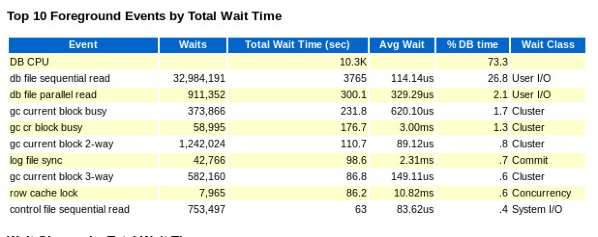
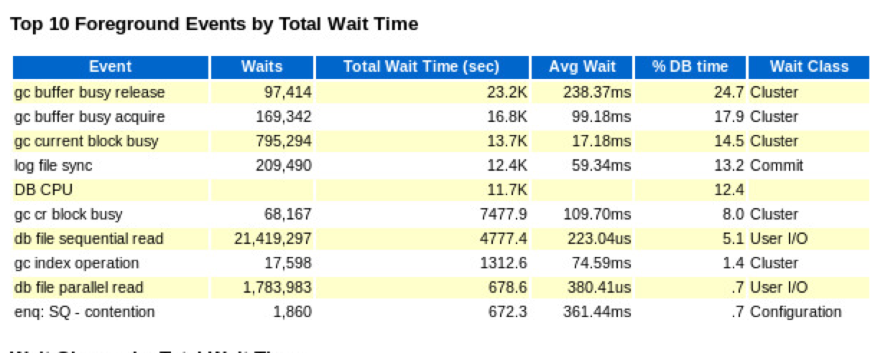
4. Service-to-Instance Affinity broken
Transaction and or data locality/affinity not working after instance failure.
Connection Storms Increase pressure and contention on resources.
Before Rebalance
After Rebalance
Note the change in Wait time distribution and avg wait time

Slide 27
5. Long Running Transactions with Concurrent Queries
Long running batch jobs & concurrent queries against the same table.
Query has to do block cleanout.
Lots of transaction metadata (undo header blocks) have to be fetched from remote instances.
A large bottleneck seen in Oracle E-Business Suite (EBS).
66% of the overall block traffic are for these metadata blocks in the following example.
CR Current
----------------------------- -----------------------------
Inst Block Blocks % % % Blocks % % %
No Class Received Immed Busy Congst Received Immed Busy Congst
---- ----------- -------- ------ ------ ------ -------- ------ ------ ------
2 undo header 697,283 98.9 1.1 .0 1,512 98.7 1.3 .0
2 data block 143,563 55.7 44.3 .0 178,039 73.4 26.6 .0
2 undo block 39,667 96.6 3.4 .0 0 N/A N/A N/A
2 Others 214 99.5 .5 .0 476 98.3 1.7 .0
Notes:
Example is from EBS.

Slide 28
6. PDB Sizing Issues
DLM locking structures (lock hash tables) are sized statically at instance/PDB startup.
If they are sized too small, the system may suffer latch contention on the following latches:
latch: ges resource hash list
latch: gcs resource hash
There is a known performance issue with PDB’s since Oracle 18c:
Performance Issues when using PDBs with Oracle RAC 19c and 18c (Doc ID 2644243.1)
From a customer escalation (18c)
Event | Waits | Total Wait Time (sec) | Avg Wait | % DB time | Wait Class
DB CPU |  | 671.7 |  | 31.3
latch: ges resource hash list | 520,732 | 551.7 | 1.06ms | 25.7 | Other
log file sync | 389,278 | 401.6 | 1.03ms | 18.7 | Commit
enq: HW - contention | 7,223 | 256.4 | 35.49ms | 11.9 | Configuration
enq: US - contention | 25,985 | 167.2 | 6.43ms | 7.8 | Other

Slide 29
Agenda
1
Introduction to RAC
2
Common Cache Fusion Messaging Patterns & Wait Events
3
Common RAC Performance Bottlenecks
4
Diagnostic Information
5
Case Studies

Slide 30
Diagnostic Information
AWR metrics and Drill Down
Cluster wait time in Top 10
DB time spent in all Cache Fusion waits.
Impact of Cache Fusion.
SQL ordered by Cluster Wait Time
Shows SQL’s responsible for the cluster waits.
Segment statistics
Shows segments (tables & indexes) responsible for the cluster waits.
Statistics available for:
Global Cache Buffer Busy, CR Blocks Received, Current Blocks Received, Global Cache Remote Grants.
Wait event histograms
Average wait in AWR report can be misleading when outliers influence the results.
Lost of RAC specific sections & metrics
See next page…

Slide 31
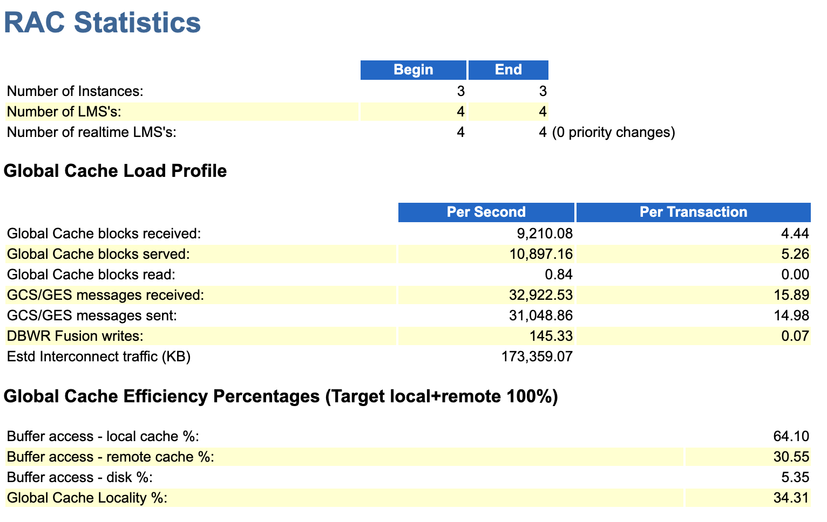

Slide 32
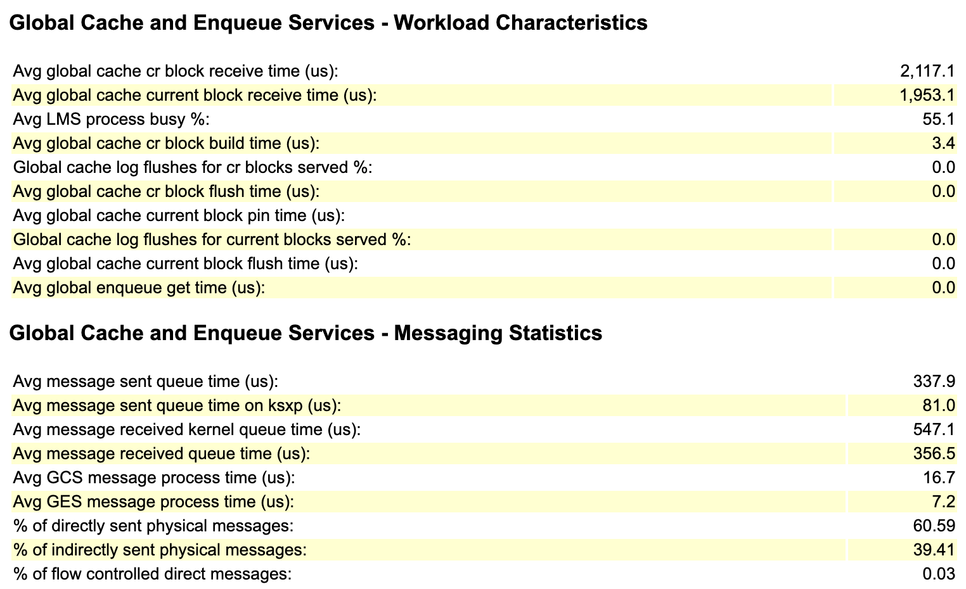

Slide 33
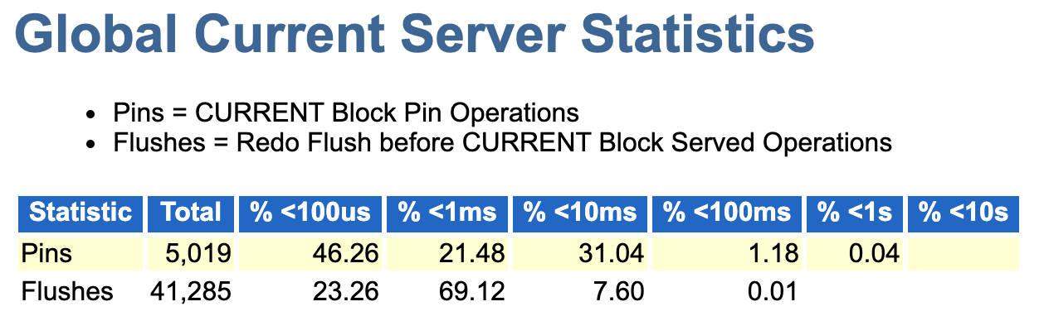
Long “Pins” times may indicate: - CPU load on serving instances, leading to slow release of pins by foregrounds
- Inefficient code where pins are held for long
- Priority inversion on serving instance (preempted while holding an exclusive pin)
Long “Flush” times usually indicate log I/O issues.

Slide 34
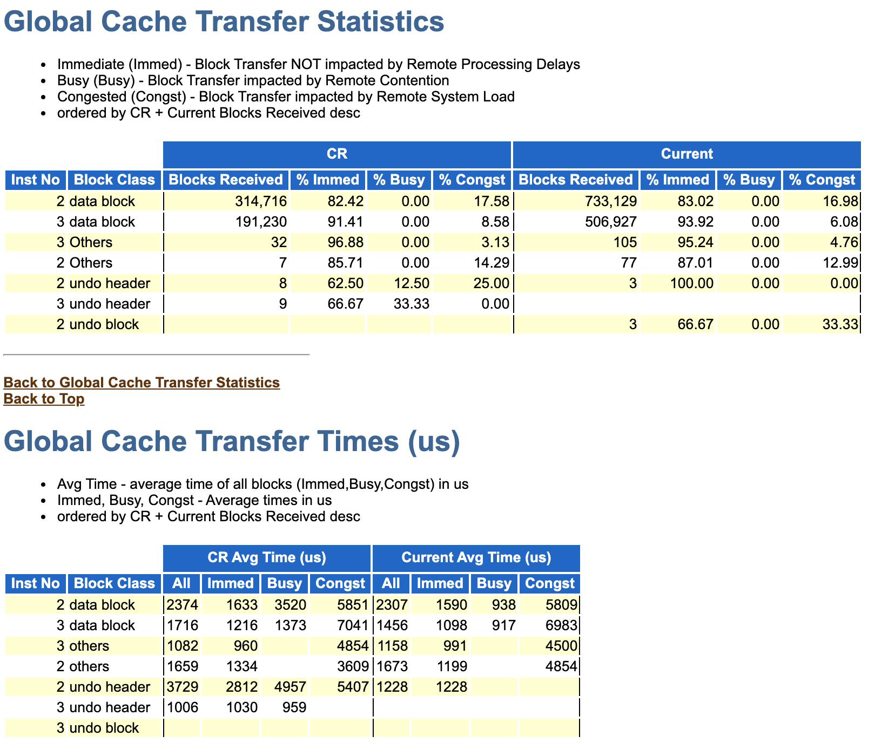

Slide 35
Diagnostic Information
Trace events
Buffer Cache
event 10708
Buffer cache (RAC)
event 10899
Buffer cache outliers
trace[GCS]
Buffer cache locking
Pin tracking (x$kcbpintime)
_pin_time_statistics=TRUE
_trace_pin_time=TRUE
Global Enqueues
trace[KSI]
Global enqueue entry point
trace[RAC_ENQ]
Global enqueue locking
General
event 10046
SQL, wait events
trace[GSIPC]
Inter-instance messaging
trace[RAC_MLMDS]
General LMS & LMD activity

Slide 36
Other Common Diagnostic Tools
If you see bad “GC” waits on one instance, it’s the other instance(s) that are slow to respond
mpstat
Focus on cores where LMS is running.
top / ps (remember to review per-thread data)
Focus on LMS activity.
/proc/interrupts
Focus on interrupts for the private interconnect.
/var/log/messages
Protocol-specific tools like rds-info

Slide 37
Agenda
1
Introduction to RAC
2
Common Cache Fusion Messaging Patterns & Wait Events
3
Common RAC Performance Bottlenecks
4
Diagnostic Information
5
Case Studies

Slide 38
Case Study: Severe Global Cache Contention ( bug 31025811 )
10 node cluster
All nodes are actively and uniformly used
Converged Infiniband RAC Interconnect and Storage
Degradation during Rolling upgrade
Sessions waiting for Global Cache after one node was upgraded
c.f. Slide 30 for procedure

Slide 39
Case Study
Impact on an instance
Impact in terms of DB Time
Anomalies
Averages higher than expected
High impact on sessions
Notes:
The first two types of workloads described in this section would typically show these characteristics.

Slide 40
Case Study
Normal and Abnormal Comparison
Current block transfers from ~600 usecs to 17 ms
Cluster Wait time < 5% when the system is normal

Slide 41
Case Study
Inference
log file parallel write -> gc [cr|current] block busy
Log writes on sender instance block cache fusion sends.
gc [cr|current] block busy -> gc buffer busy acquire
”busy” indicates delay of a cache fusion request due to a log flush or a buffer pin
gc buffer busy is indicative of serialization.
.
Hypothesis 1: Redo Log Writes ?
Hypothesis 2: Slow release of pins ?

Slide 42
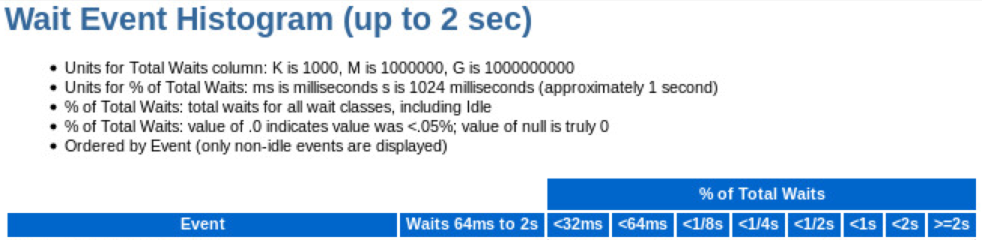
Case Study
Impact of Outliers on Cluster Waits and Commits
Histograms are subdivided into usec , ms, and sec buckets
Notes:
The first two types of workloads described in this section would typically show these characteristics.

Slide 43
Case Study
Impact of Outliers on Cluster Waits and Commits
Histograms are subdivided into usec , ms, and sec buckets
good
Notes:
The first two types of workloads described in this section would typically show these characteristics.

Slide 44
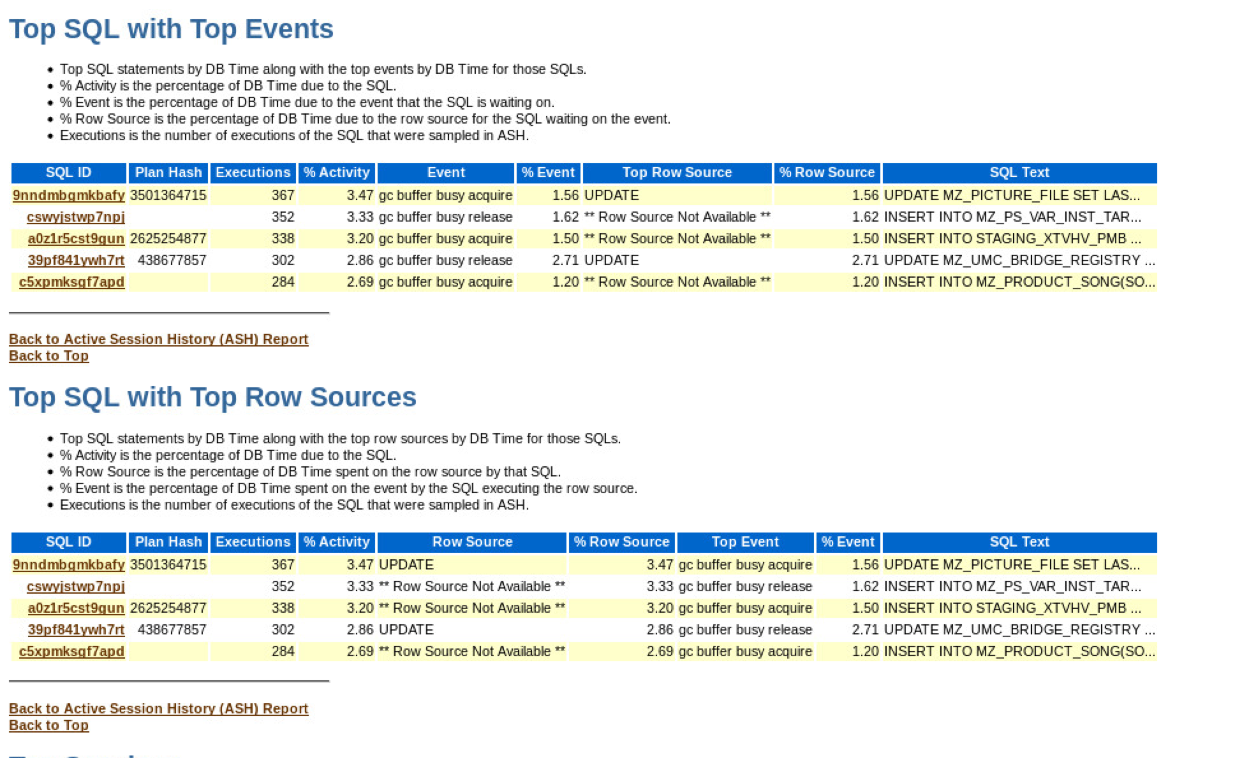
Case Study
Which Part of the Application is affected most ?
Notes:
The first two types of workloads described in this section would typically show these characteristics.

Slide 45
Case Study
Impact of Globally Hot Blocks on Application SQL
DML -> gc current block busy -> gc buffer busy acquire
UPDATE/INSERT/DELETE access current blocks
SELECT -> gc cr block busy. -> gc buffer busy acquire
Queries can do cr reads on modified blocks
.

Slide 46
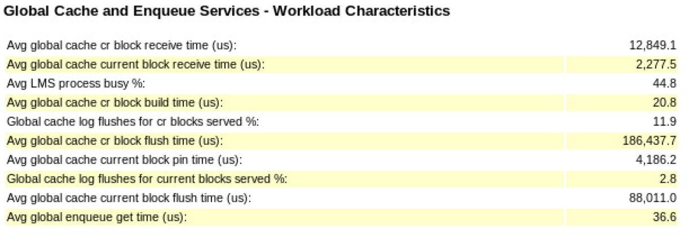
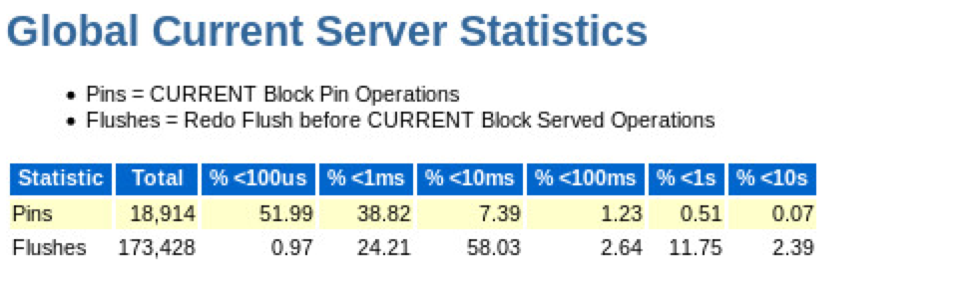
Case Study
Global Cache Server Performance
High pct of log flushes
High Pin Times
High Flush Times
Notes:
The first two types of workloads described in this section would typically show these characteristics.

Slide 47
Case Study
Causes of Global Cache Contention
Long “Pins” times may indicate: - CPU load on serving instances, leading to slow release of pins by foregrounds
- Inefficient code where pins are held for long
- Priority inversion on serving instance (preempted while holding an exclusive pin)
Long “Flush” times usually indicate log I/O issues.
Notes:
The first two types of workloads described in this section would typically show these characteristics.

Slide 48
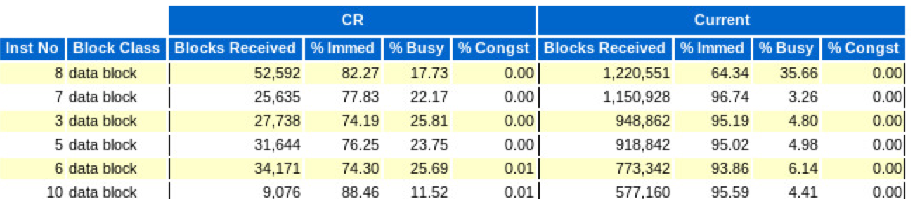
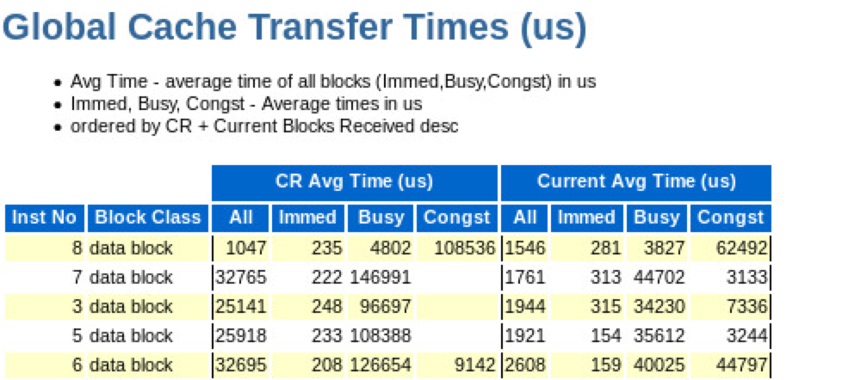
Case Study
Per-instance Cache Fusion Receiver Performance:
View from 1 instance in the cluster
Skew on Instance 8
Notes:
The first two types of workloads described in this section would typically show these characteristics.

Slide 49
Case Study: Next Steps Correlation with OS/ExaWatcher
Look for IO reasons which can explain the log flush performance.
Additional data from log and trace files (e.g. LGWR trace files)
Look for CPU load or indication of preemption ( busy processes in high priority )
OS/ExaWatcher
Application is not the problem
Performance is good before the incident
Caution: logon storms and rebalance may expose hot spots
The high impact of outliers may require time series-oriented approach
Identify periods with outliers
Active Session History
rdbms/admin/awrextr.sql
EM
ADAT

Slide 50
… to be continued
Global Enqueue Service
Dynamic Remastering
Instance Join/Leave Reconfiguration
Please send questions to Slack channel #www-rac-int
Slides will all be uploaded to confluence page: https://confluence.oraclecorp.com/confluence/x/IxNJc

Slide 51
Questions?

Slide 52
Thank you
Michael Zoll, Atsushi Morimura
RAC Performance Group

